Slide 1


Customer Analytics in the Telecommunication Industry
Presented by :
Saayan samanta

Slide 2
Project Objective
Identify customer segments and usage patterns.
Understand potential service-quality issues.
Support customer retention and network improvement.
Assess the operational growth opportunities relevant to acquisition.

Slide 3
Dataset Overview
Attribute | Description
Records | Approximately 150,001
Features | 55
Data type | Telecom xDR / session-level records
Customer identifier | MSISDN
Network metrics | RTT, TCP retransmission, throughput
Usage metrics | Download, upload, application traffic
Device information | Handset type and manufacturer

Slide 4
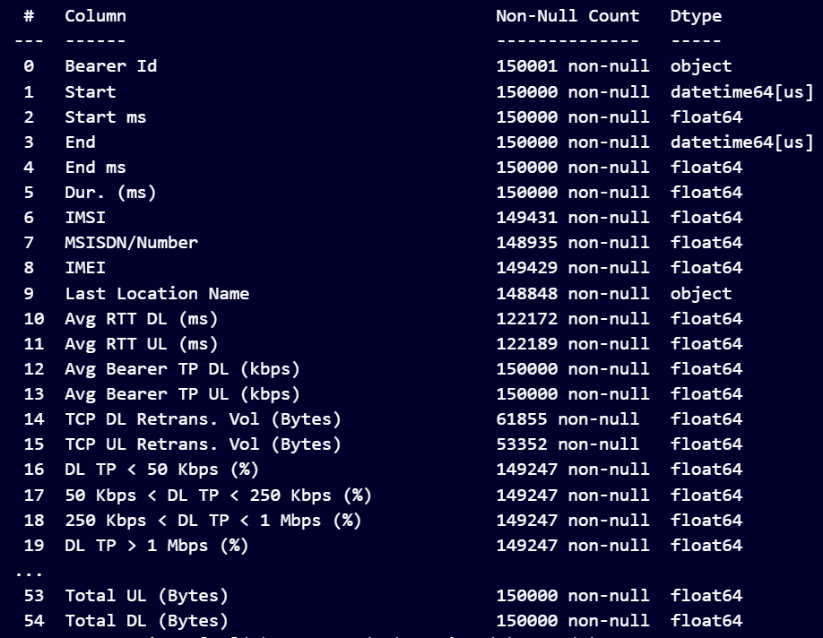
Dataset Overview
Customer & Session Details: MSISDN, IMSI, Bearer ID, session start/end time, and session duration.
Device Information: IMEI, handset manufacturer, and handset type for understanding device-level usage patterns.
Network Performance: RTT, TCP retransmission, and average DL/UL throughput to evaluate network quality and performance.
Data Consumption: Total Download (DL) and Upload (UL) volumes to measure customer data usage.
Application Usage: Data consumption across YouTube, Netflix, Social Media, Google, Email, Gaming, and other applications.

Slide 5
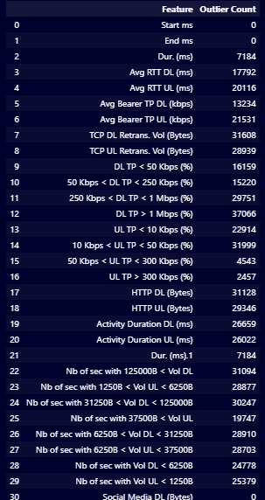
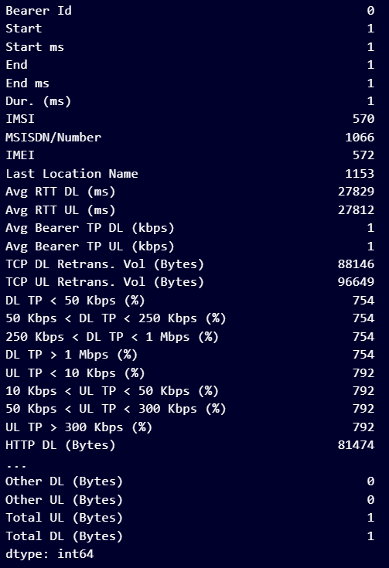
Missing data and Outlier identification
High Missing Values: Network and technical features such as RTT, TCP retransmission, HTTP traffic, and throughput contain significant missing data.
Critical Missing Feature: Nb of sec with 37500B < Vol UL has the highest missing count of 130,254 records.
Significant Outliers: Outliers are mainly concentrated in throughput, RTT, TCP retransmission, and activity-duration features.
Application Data Quality: Application-level features such as YouTube, Netflix, Gaming, Social Media, Google, and Email show no detected outliers.

Slide 6
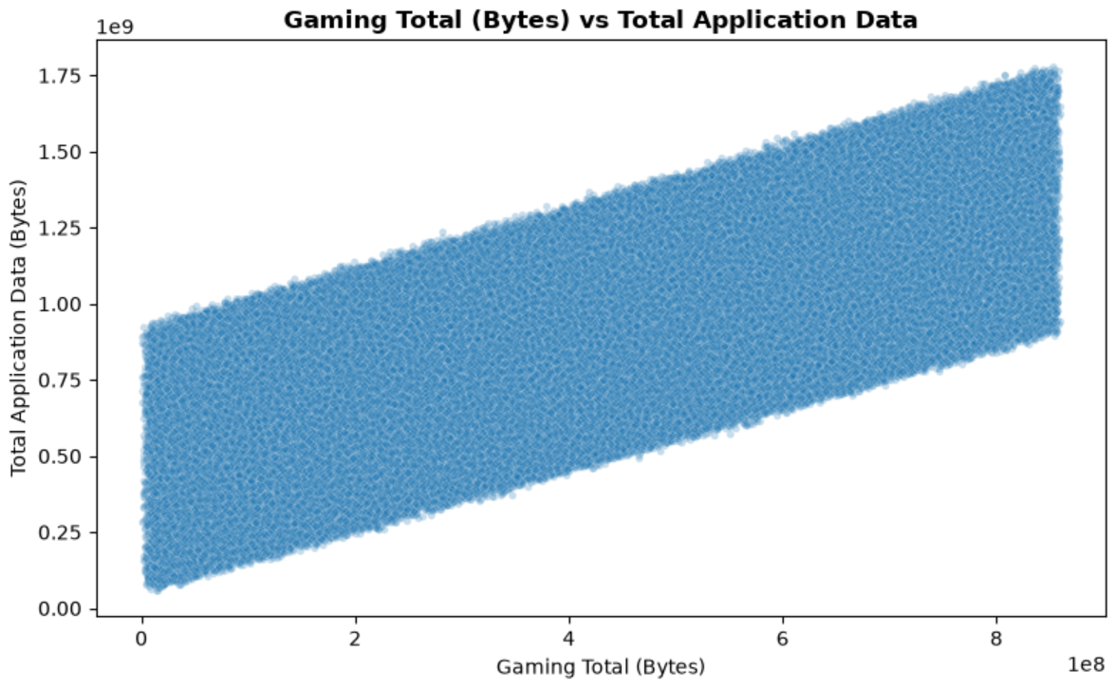
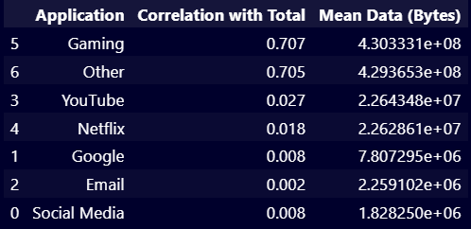
Customer Overview & Usage Patterns
Users consume a significant portion of their mobile data through gaming activities, making gaming a major contributor to overall data consumption compared with social media, YouTube, and other applications.

Slide 7
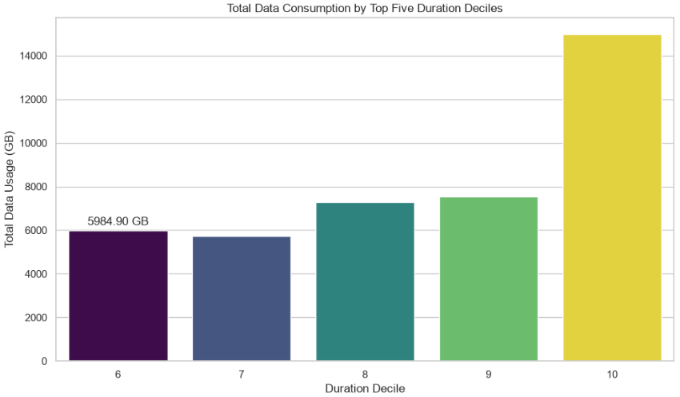
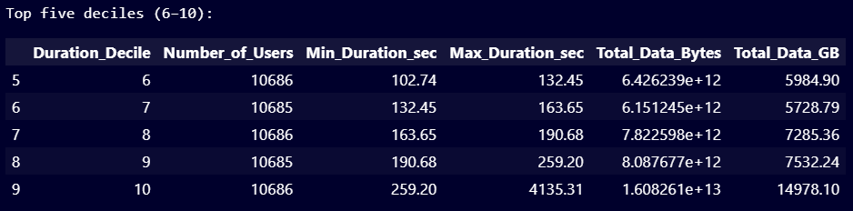
Customer Overview & Usage Patterns
Users are divided into 10 deciles, with each group representing approximately 10% of valid users.
Decile 0 represents users with shorter session durations, while Decile 9 represents users with the longest sessions.
Decile 9 records session durations ranging from 259.2 to 4,135.31 seconds.

Slide 8
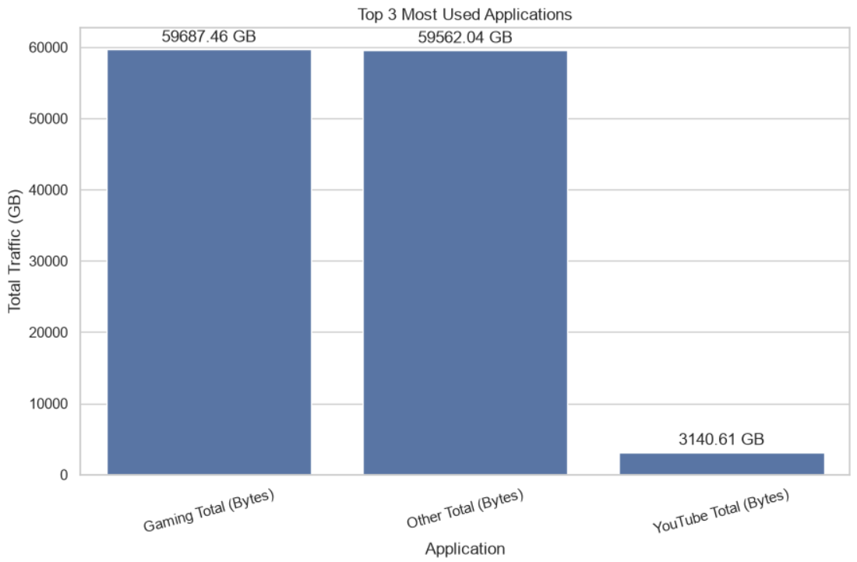
Customer Engagement
The high traffic contribution from gaming highlights gaming users as an important segment for data-plan and service optimization.
Users with high gaming or video consumption can be offered higher-data plans, add-on packs, or premium data bundles based on their usage patterns.

Slide 9
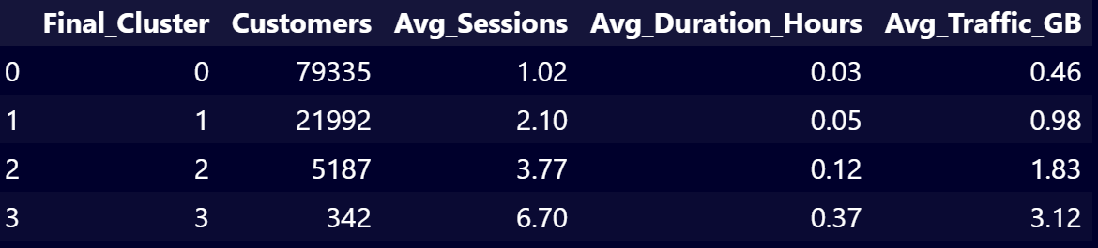
Customer Engagement
Based on Avg Sessions, Avg Session Duration, and Avg Traffic, the four clusters are created to differentiate levels of user engagement.
Customer engagement increases progressively from Cluster 0 to Cluster 3, with higher session frequency accompanied by longer usage duration and greater data consumption.
Cluster 2 can be prioritized for revenue expansion because it combines high engagement with a sizeable customer base, while Cluster 3 represents a smaller high-value segment suitable for premium offerings.

Slide 10
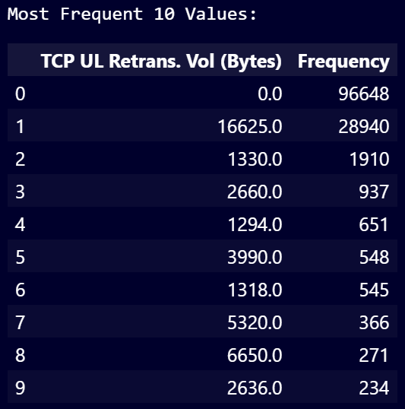
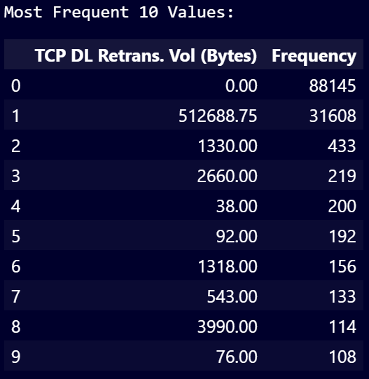
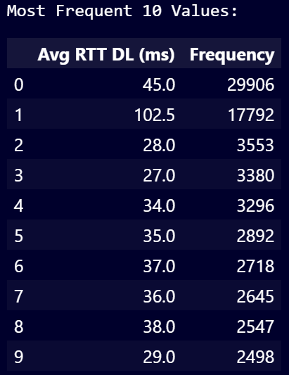
Customer Experience
TCP DL Retransmission: High retransmission in 31,608 records may cause download delays, buffering, and inconsistent browsing/streaming experiences.
TCP UL Retransmission: 28,940 records show notable upload retransmission, potentially affecting uploads, video calls, and real-time applications.
Avg RTT DL: 17,792 records have a high RTT of 102.5 ms, which can result in slower response times and reduced responsiveness.

Slide 11
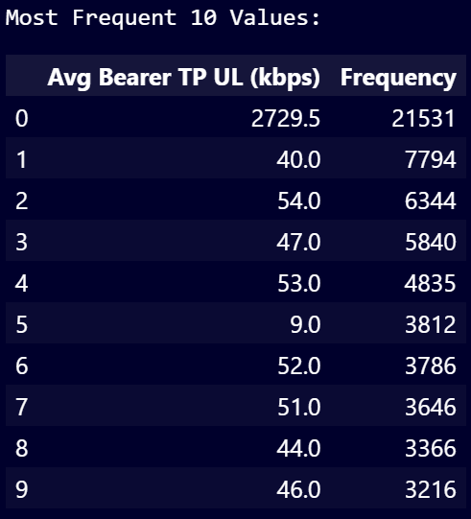
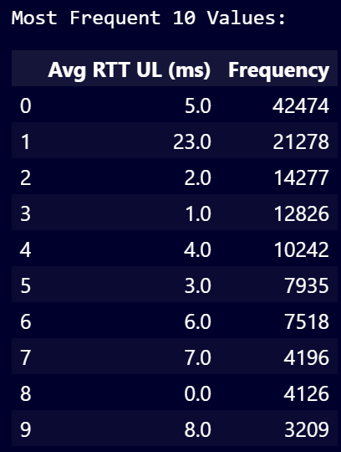
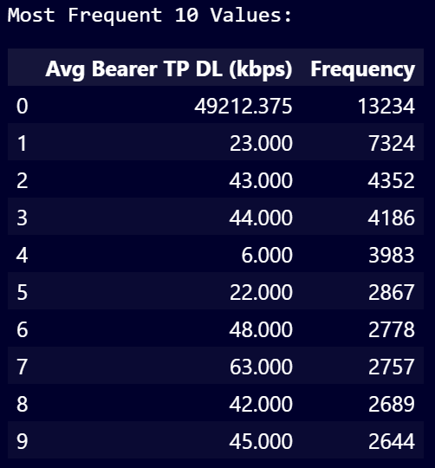
Customer Experience
Avg RTT UL: Most users show low RTT, with 5 ms recorded in 42,474 records, indicating generally responsive upload communication.
Avg Bearer TP DL: The wide variation from very low throughput to 49,212 kbps indicates uneven download experience across users.
Avg Bearer TP UL: The variation in upload throughput indicates that some users may experience slow uploads and reduced real-time communication quality.

Slide 12
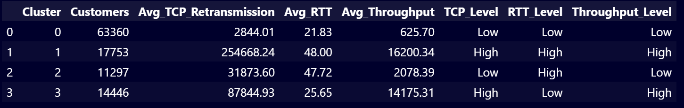
Customer Experience
The four clusters were formed using Average Sessions, Average Session Duration, and Average Traffic to segment customers based on their levels of user engagement.
The clusters reveal different network-experience patterns:
Cluster 1 requires attention to retransmission and network load.
Cluster 2 represents a lower-throughput/high-latency segment.
Cluster 3 combines strong throughput with elevated retransmissions.

Slide 13
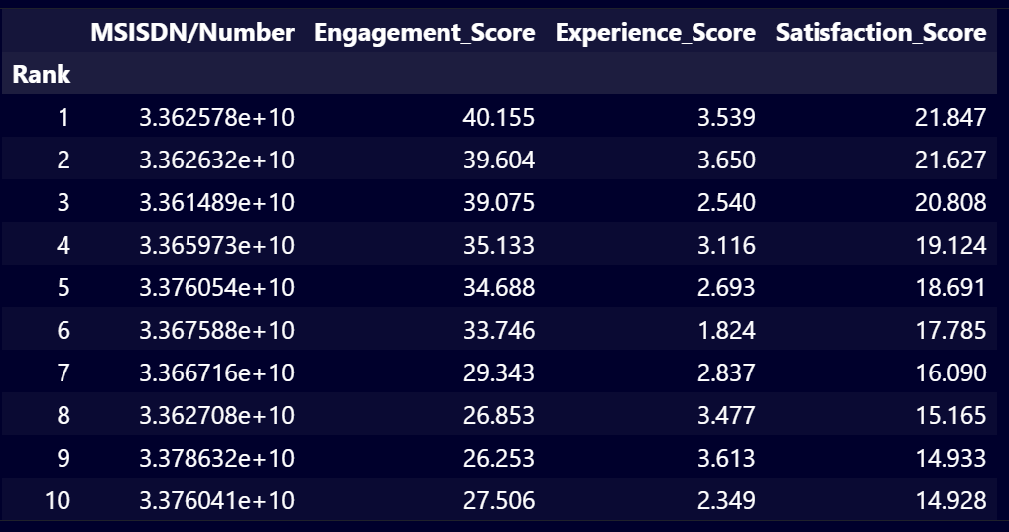
Customer Satisfaction
Satisfaction Score = (Engagement Score + Experience Score) / 2.
Top 10 customers have combined scores ranging from 14.928 to 21.847, enabling the business to identify customers requiring further customer-level analysis.
Combining engagement and experience provides a single framework for prioritizing customer-level analysis rather than evaluating usage and network experience separately.
The ranking can be used to identify customer groups for further investigation, personalized service strategies, and deeper satisfaction analysis.

Slide 14
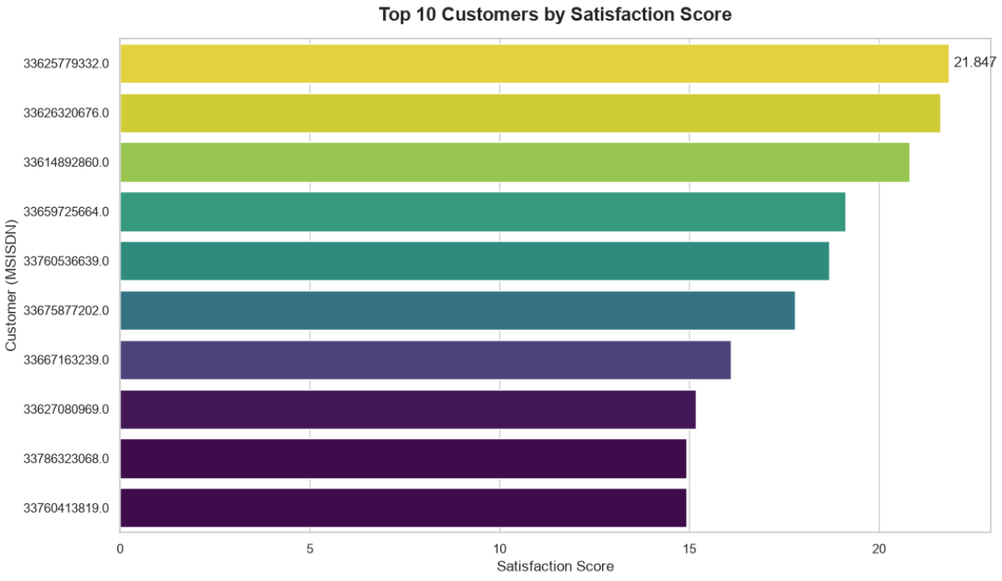
Customer Satisfaction
Prioritize high-engagement customers for retention and premium service offerings.
Identify experience issues among highly active users to prevent dissatisfaction and potential churn.
Personalize plans and offers based on individual engagement and usage patterns.
Use the ranking for targeted intervention, combining customer behaviour with network-performance insights.
Enhance future scoring by incorporating revenue, ARPU, churn, and complaints for stronger business decisions.

Slide 15
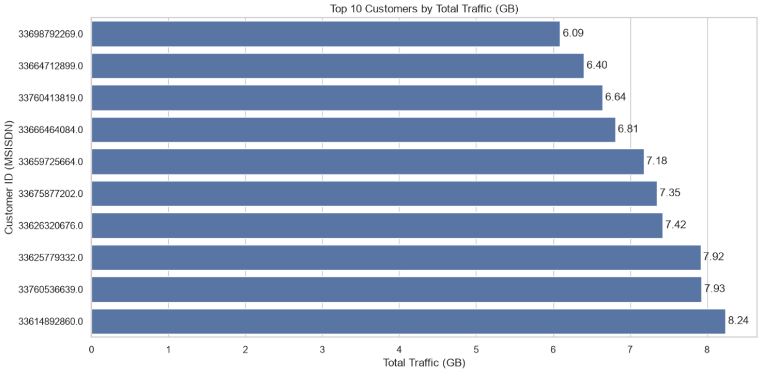
Growth Potential of the Company
The analysis indicates positive growth potential through customer retention, revenue expansion, network optimization, and data-driven operations, though the company may be able to improve performance and customer value:
Customer Retention: Identify less-engaged customers and address their usage or service issues to improve retention and reduce potential churn.
Revenue Growth: Target highly engaged customers with personalized data plans, add-ons, and services based on their application and traffic usage patterns.

Slide 16
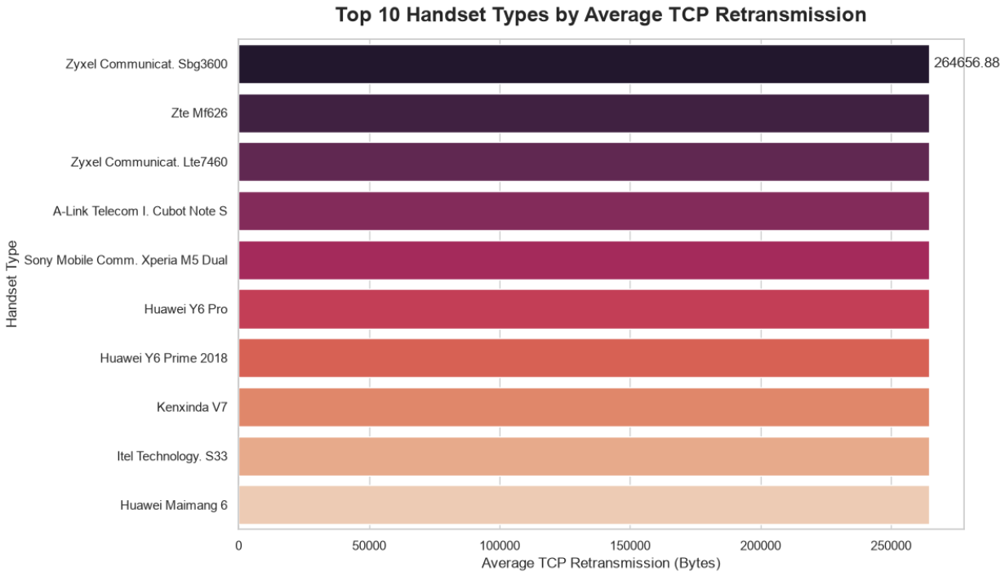
Growth Potential of the Company
Network Optimization: Improve high-latency and high-retransmission areas to enhance customer experience and support higher-quality service usage.
Customer Experience: Use engagement and network-performance insights to identify service gaps and improve overall user experience.
Data-Driven Growth: Continuously monitor customer segments, usage patterns, and network performance to support targeted and informed business decisions.

Slide 17
Limitations for analysis
Data Limitations
Dataset covers a specific period and may not reflect current or future performance.
Missing values, outliers, and data inconsistencies may affect results.
Business Limitations
Dataset lacks profitability, market share, CAPEX, and financial data.
No ROI or financial valuation was performed.
Business opportunities require validation with financial and operational data.
Analytical Limitations
K-Means results depend on feature selection, scaling, and cluster count.
Cluster labels indicate relative patterns, not absolute quality levels.
Satisfaction score is a proxy based on cluster distances, not actual survey data.
Regression predicts a constructed score, not future satisfaction.
Observed relationships do not establish causation.

Slide 18
Acquisition Recommendation
Growth Potential: The analysis identifies opportunities to improve customer engagement, network experience, and retention.
Financial Uncertainty: Available data does not establish the acquisition’s potential financial return.
Recommendation: Proceed with further acquisition evaluation, rather than immediate purchase approval.
Due Diligence: Validate financial, technical, customer, and legal aspects before making the final investment decision.
Final Takeaway: Operational potential is evident, but acquisition viability requires comprehensive due diligence.

Slide 19
References
Telecom xDR dataset supplied for the project.
Project data preprocessing and exploratory analysis.
Scikit-learn documentation — K-Means clustering, Random Forest Regression, and evaluation metrics.
Pandas documentation — data aggregation and analysis.
Matplotlib and Seaborn documentation — data visualization.

Slide 20


